Slide 1

‘Get that Job’
Session
Leanne Droogan
Workforce Development Lead
Wigan Childrens Social Care

Slide 2
Get that Job Session
Aims and objectives
To consider the skills required of a social worker
To provide job application form planning tips
To provide tips when writing a job application form for a social work position
To understand what employers are looking for in an application, and what may prevent you progressing to interview
To consider how to prepare for an interview
To provide tips on interviewing skills

Slide 3
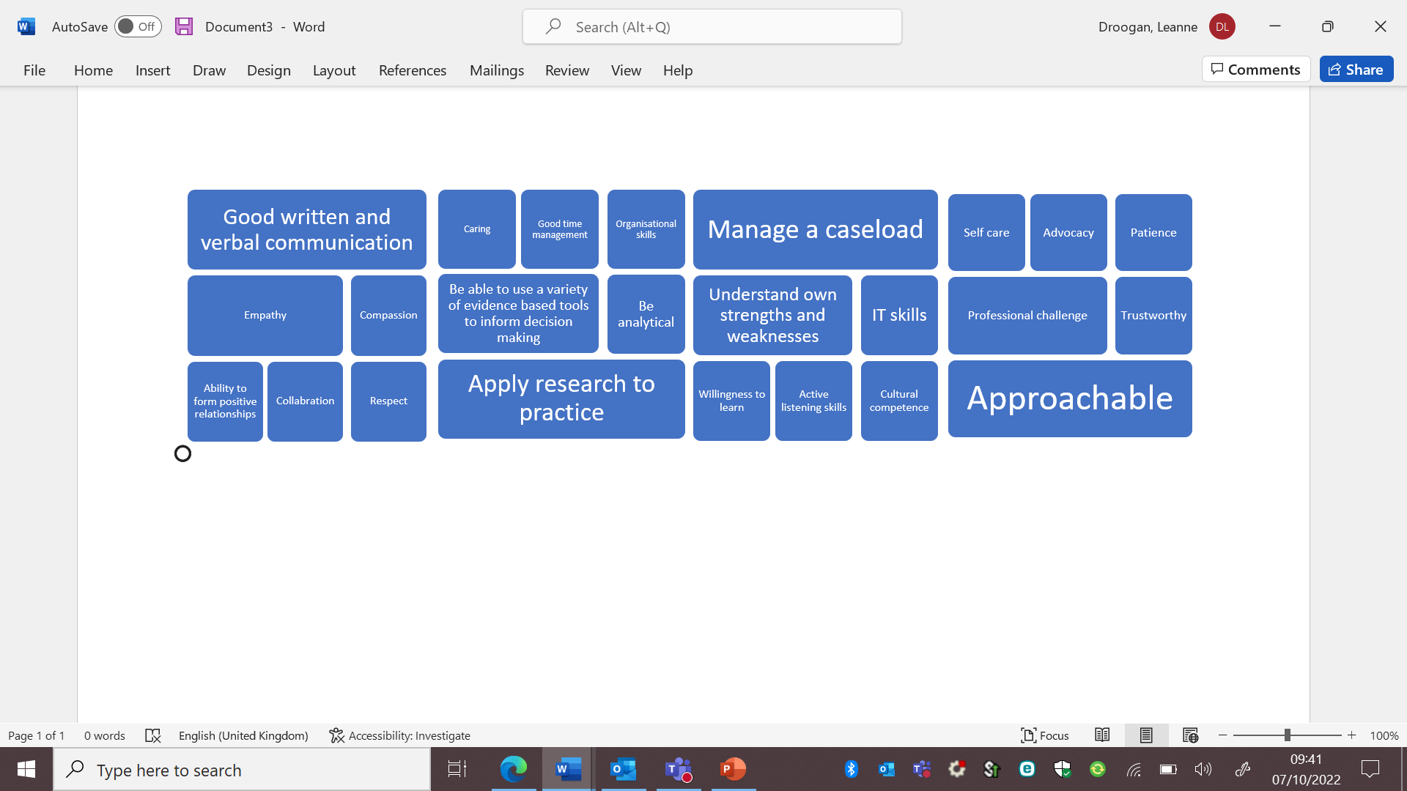
Get that Job Session
Skills

Slide 4
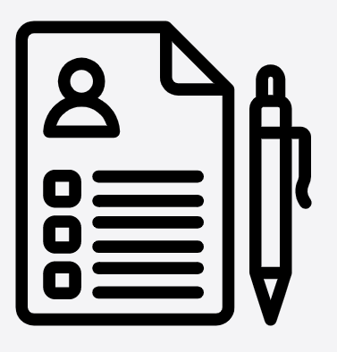
Get that Job Session
Applying for a social work role
Job specifications
Completing a job application form
Preparing for interview
Interviewing

Slide 5
Get that Job Session
Job Specification
Social work qualification
Registration with Social Work England
Experience of partnership working
Experience of a broad spectrum of services within the field of social work
Knowledge and understanding of legislation that governs social work practice
Excellent analytical and judgement skills
Good time management skills and the ability to work to deadlines and manage conflicting demands
Good level of IT skills
Someone who is caring, warm-hearted, down to earth and thoughtful
Someone who has the ability to stand in other people’s shoes
Someone who is inquisitive, with good communication skills, and good listening skills
Someone who is good at solving problem

Slide 6
Get that Job Session
Writing the job application form
Print out the job specification and make some notes for each point
Cover each point within the job specification in your application – Explain how you can evidence this, give detail, and show your understanding
Be creative in your thinking - meeting each point doesn’t have to link directly to experience in social work practice
Research the organisations ethos, and evidence how you will promote these. For example at Wigan Council there are Be Wigan Behaviours – Be positive, Be accountable, Be courageous and Be kind.
Be clear you are willing to learn and develop your skills – evidence this, and highlight where your gaps are in learning, and how you are willing to learn to fill these.
Bring yourself to life and promote what you can offer that makes you stand out from other applicants – make your passion for the role shine though.
Remember this is the employers first impression of you so make it count! – Proofread before submitting

Slide 7
Get that Job Session
What employers are looking for in an application
Your skill set, communication, written, analytical skills, and evidence of these skills in your application.
Your knowledge of Social Work, information relevant role, legislation, values, responsibilities, and duties required, evidence of these in your application.
Case examples relating to the question eg: I am a good communicator- HOW. Back this up with a brief example. I understand the Care ACT- HOW?
Sounds simple but answer the question! You will be surprised how many applicants don’t get shortlisted as they have missed the point of the question.
What would make an employer reject an application?
Not enough effort
Poor spelling and grammar throughout
Not having the correct credentials ie: the right qualification, driving license if essential car user
Disrespectful language or use of ‘slang’ or abbreviations (these differ in each local authority/ organisation)

Slide 8
Get that Job Session
Ways to make your application stand out
Possible reason(s) as to why a recruiter would select one Applicant over another (with all other things being equal):
Spelling & Grammer, use of language eg: patients is a no-no!
Passion and enthusiasm shines through- not just what you know.
A preference/knowledge about the LA you are applying for eg: I would love to work in …..(LA)…..because…
A well laid out application which is easy to read and follow
Enough detail without it being an essay but evidences you have put the effort into the application as you want the job.

Slide 9
Get that Job Session
Where supportive statements are requirement
A useful model to use is the CAR Model (Bluesteps (2011) CAR Interview Techniques).
Supporting statements need to provide evidence of the skills, attributes, and knowledge the employer is looking for.
The CAR model is useful for this:
Context: What was the situation or your understanding of the issue, what was the task/process were you required to carry out? Keep it brief, but specific.
Action: What did YOU do? What was YOUR role? What actions did YOU take? Give practice examples using active language. – link theory/research as well as knowledge, skills and values to your practice examples
Result: What was the outcome? What did you achieve? What was improved? Qualify and quantify. – link to knowledge skills, values

Slide 10
Get that Job Session
Before the interview
Ensure you know the location of the interview - If you are unclear on the location go back to the employer for more information
Plan how you will get there and how long the journey will take - consider a ‘trial run’ at the similar time of day to the interview to ensure you have enough time.
Re-read the job specification and employer specification
Do your research – Ofsted reports, employees priorities, organisational ethos
Consider potential interview questions
Prepare your interview clothes a few days before the interview
If you have a disability and need any arrangements, then let the employer know in advance

Slide 11
Get that Job Session
On the day of interview
Give yourself plenty of time to get ready. Make contingency plans for looking after children, etc
Make sure you take the documents requested of you, e.g. qualification, certificates, ID, SWE registration, etc
Take the letter inviting you to the interview containing the information on who you are to meet there so you can provide this on arrival
Be there in plenty of time so that you arrive 10 minutes early. Sometimes it is a good idea to get there even earlier and take the opportunity to have a drink in the local coffee shop - Never arrive at the interview ‘very’ early or late.
Know your own triggers

Slide 12
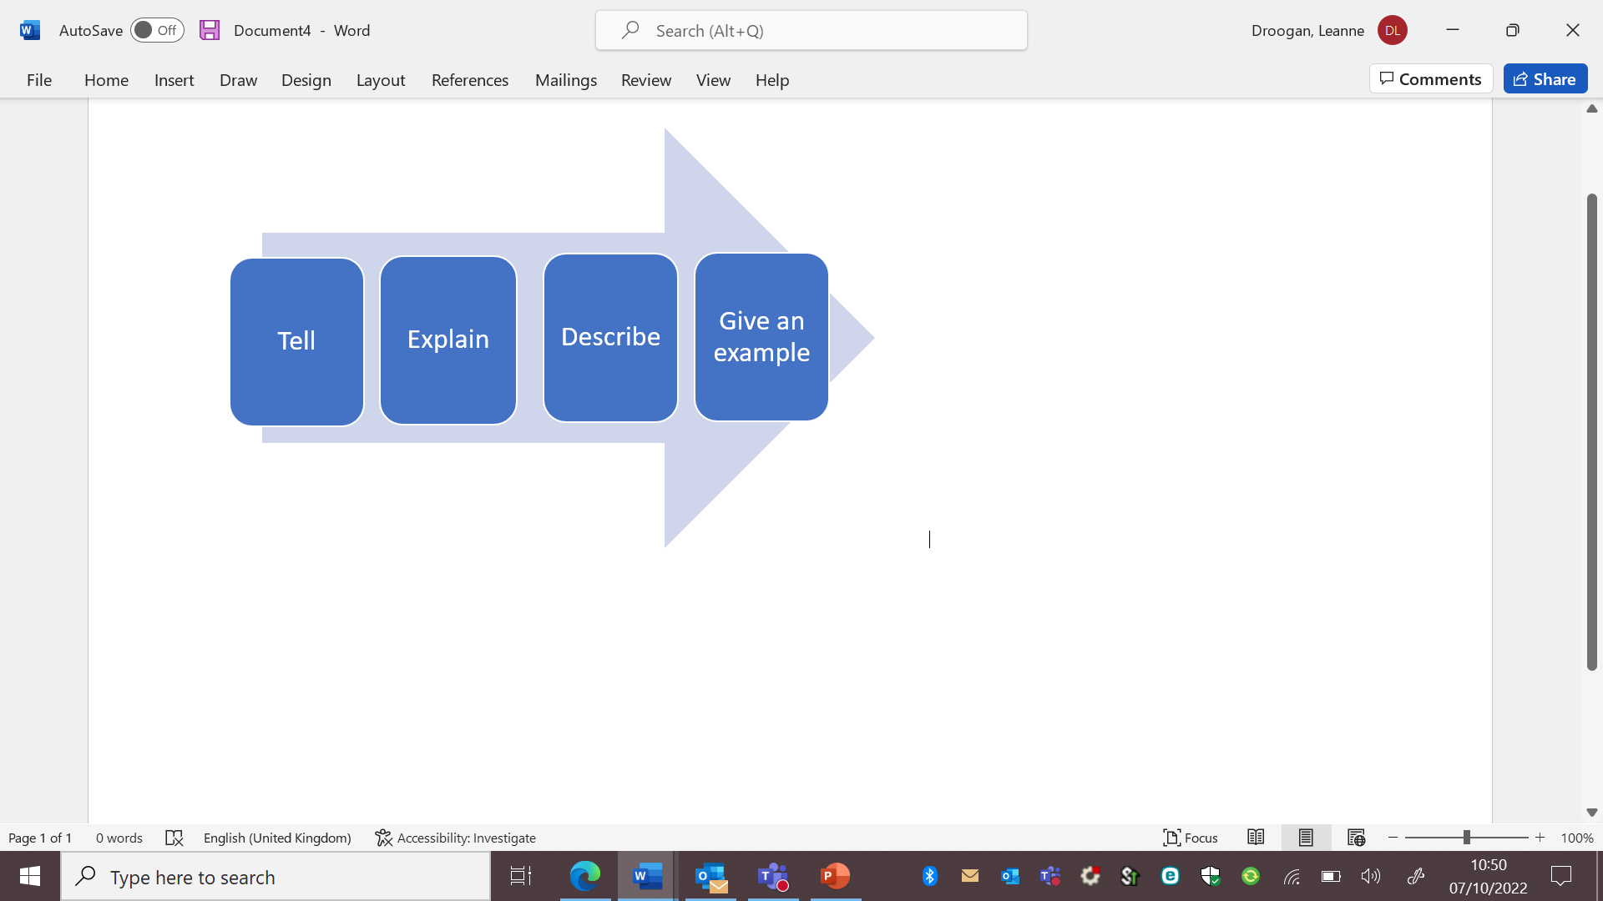
Get that Job Session
In the interview

Slide 13
Get that Job Session
Interview questions
Set questions
Panel will probe when necessary
Some questions will be knowledge based, for example to do with legislation, some competency based and some of personal values
Most questions will be open questions as opposed to closed questions
Listen carefully, if you don’t understand then don’t be afraid to ask the interviewer to repeat or rephase the question
Work on gaining a rapport with the interview panel and don’t panic if you make a mistake, stay focused
If you have forgot to say something, at the end ask the interview panel if you can go back to a question.

Slide 14
Get that Job Session
Example interview questions
1. We expect that regular, quality supervision takes place. What does good supervision feel like to you and how would you ensure that, as reflective practitioner, you received it? How would you challenge if you didn’t? - Competence
2. Share how you approach building and developing relationships with children, families and other key partners in your current role – Competence and values
3. Can you tell us a little more about you, what energises you, how do you take care of your own wellbeing, resilience and what are your hopes for the future? - Values
4. Please can you tell us about your skills and qualities, and knowledge and experience and how your values fit with the ethos of the local authority which make you the best candidate for this role? - Knowledge and Competence
5. You may be given a case scenarios, consider your answers, take time and think about processes - knowledge

Slide 15
Get that Job Session
Example interview questions
6. What is your motivation for applying for this post and why do you want to work in CSC in this local authority? – Values
7. Tell me what you know about legislation and policies that governs social work practice, and your awareness of recent research – Knowledge
8. You may be asked to complete a presentation, or to bring in an object such as something you think symbolises your values as a Newly Qualified Social Worker and how you promote and develop excellent practice. You may be asked to speak about this - Values

Slide 16
Get that Job Session
What employers are looking for in NQSW’s
Know yourself well and have good knowledge of your strengths and weaknesses
Have good knowledge of the organisation you are applying to
Be a good communicator and be able to communicate your passion for the role you are applying for.
Can carry across their respect for the people we serve – ethics
Demonstrate that you are willing to learn
Your passion and enthusiasm for the post and Social Work – the application and interview isn’t just about what you know, they are looking for your core values and what motivates you.
For those applying for children and families social work – demonstrate they are extremely child focused and understand the value of the voice of the child and for those applying for positions in adults demonstrate the importance of the voice of the adult.
Honesty: Asa Newly Qualified Social Worker, we don’t expect you to know everything. Be honest about this but add you want to learn more about this i.e. I am dedicated to developing my Skills & Knowledge in this area through training/learning from peers.

Slide 17
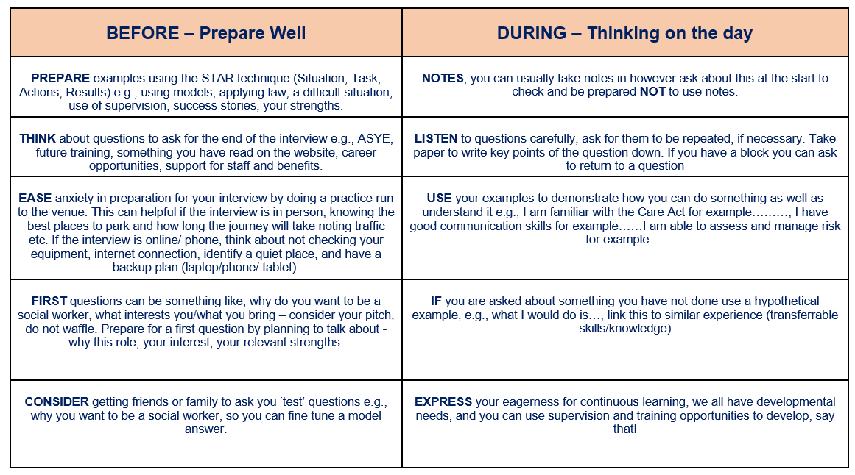
Get that Job Session

Slide 18
Get that Job Session
REMEMBER EMPLOYERS WANT YOU
AS MUCH AS YOU WANT THEM!
Good Luck 😊

