Slide 1

An introduction to the Assessed and Supported Year in Employment (ASYE)
Beth Hudson
Workforce Development Lead
Wigan Childrens Social Care

Slide 2
ASYE
Aims and objectives
This session aims to arm you with:
the knowledge and information of what the ASYE is
how it can be run
what to expect from your first year in practice.

Slide 3

ASYE
What do you already know?

Slide 4
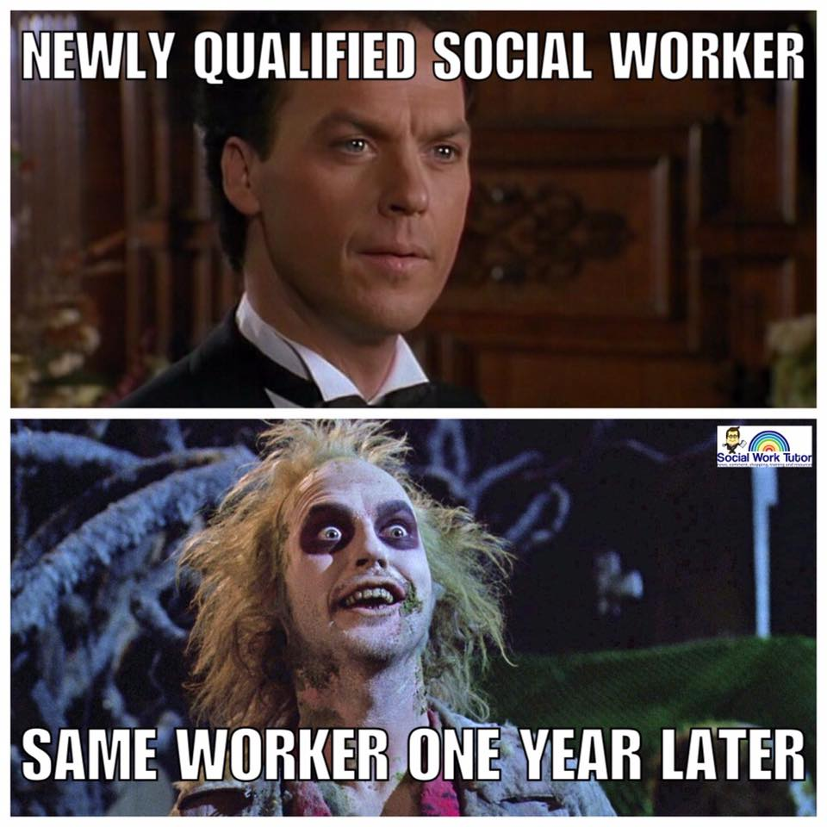
ASYE
Notes:
Talk about the importance of building resilience and skills to look after self
Building your ‘social work family’ and taking support from your team and colleagues – thinking about hybrid working and balancing this with the experience and skills you take from being with experienced staff and others
Journey through from unconscious incompetence to conscious competence

Slide 5
ASYE
Social workers: Assessed and supported year in employment (ASYE): Challenges and rewards (youtube.com)

Slide 6
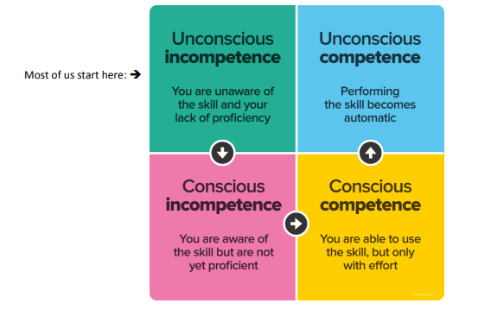
Notes:
Unconscious incompetence (Ignorance) The individual does not understand or know how to do something and does not necessarily recognize the deficit. They may deny the usefulness of the skill. The individual must recognize their own incompetence, and the value of the new skill, before moving on to the next stage.
[2] The length of time an individual spends in this stage depends on the strength of the stimulus to learn.
[3] 2. Conscious incompetence (Awareness) Though the individual does not understand or know how to do something, he or she does recognize the deficit, as well as the value of a new skill in addressing the deficit. The making of mistakes can be integral to the learning process at this stage.[4]
3. Conscious competence (Learning) The individual understands or knows how to do something. However, demonstrating the skill or knowledge requires concentration. It may be broken down into steps, and there is heavy conscious involvement in executing the new skill.[3]
4. Unconscious competence (Mastery) The individual has had so much practice with a skill that it has become "second nature" and can be performed easily. As a result, the skill can be performed while executing another task. The individual may be able to teach it to others, depending upon how and when it was learned

Slide 7
ASYE
Assessment requirements
NQSWs should be assessed against the following Post Qualifying Standards (PQS, formerly known as the KSS)
Child and Family Post Qualifying Standards (includes NQSWs placed in CAMHS)
Adult Services Post Qualifying Standards (includes NQSWs placed in adult mental health services)
Notes:
How is it assessed?

Slide 8
ASYE – Children’s
Relationships
and effective direct work
Communication
Child Development
Adult mental ill health
Abuse and neglect of Children
Child and Family assessment
Analysis, decision making and review
The Law and Family Youth Justice
The role of supervision
Organisational context

Slide 9
ASYE – Adult’s
The role of social workers working with adults
Person Centred Practice
Safeguarding
Mental Capacity
Effective assessments and outcome based support planning
Direct work with individuals and families
Supervision, critical reflection and analysis
Organisational context
Professional ethics and leadership

Slide 10
ASYE
Why?
Employer benefits
Workforce retention
Social workers remain in the profession and continue to develop and progress throughout their social work career.
High standards of practice
Deliver positive outcomes for children, young people, families, and adults who draw on care and support.
Who is the programme for?
Registered social workers.
NQSWs employed in child and family, adult or mental health services.
Agency NQSWs.
Social workers qualified up to four years.
Notes:
Registered social workers who are employed in a social work role or in a role that meets and evidences the relevant post-qualifying standards.
NQSWs employed in child and family, adult or mental health services, within the statutory or PVI (private, voluntary, independent) sectors.
Agency NQSWs - an agreement will need to be made as to whether the agency or host employer fulfils the ASYE requirements.
Social workers qualified up to four years. After four years organisations can use the ASYE programme, but they will not receive funding or certification from Skills for Care.

Slide 11
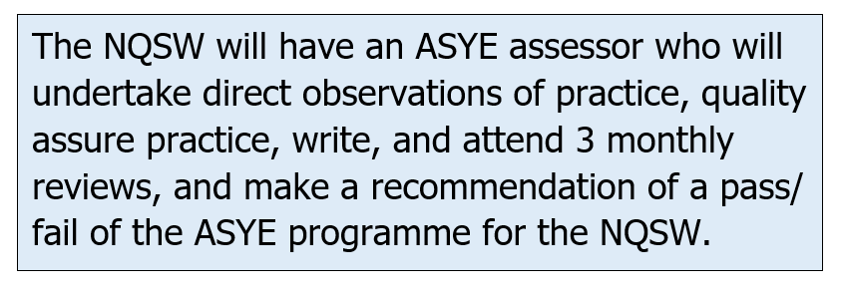
ASYE
The Assessed and Supported Year in Employment (ASYE) is a 12-month, employer led and employment-based programme of support and assessment for newly qualified social workers (NQSWs)
The programme is for all sectors (statutory and private/voluntary/independent) and across child and family, adult and mental health services. It requires the NQSW to complete a portfolio of evidence that is split into 5 parts
Part one – Beginning the ASYE
Part 2 – 0 – 3 months
Part 3 – 3 – 6 months
Part 4 – 6 – 9 months
Part 5 – 9 – 12 months

Slide 12
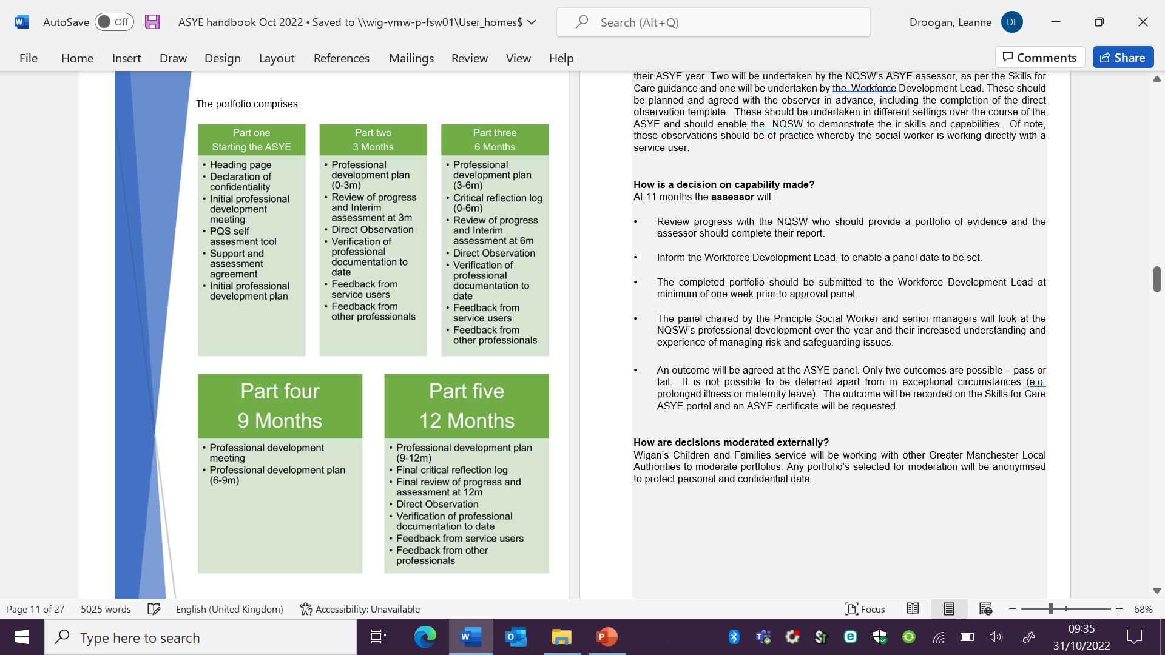
Notes:
PDP – 5 parts
Direct observations – 3
Verification of professional documentation – 3
Feedback from service users – 3
Feedback from other professionals – 3
CRL – 2
Review of progress – 4 (with one being a check in)

Slide 13
National context - The independent review of children’s social care final report
Realising the potential of the workforce
Setting out career development frameworks and addressing pay disparities
Providing an Early Career Framework for the first five years in the profession
Enabling career progression without leaving direct practice through an Expert Practitioner Pathway
Creating national pay scales to increase consistency and reward expertise.

Slide 14
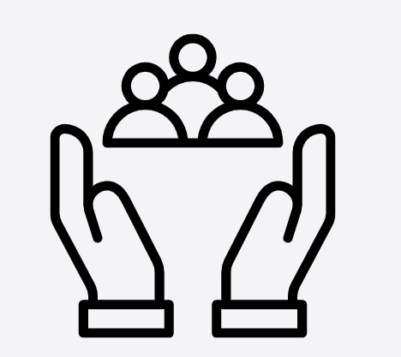
ASYE
ASYE with Wigan
Wigan Council are committed to investing in newly qualified social workers as the workforce of tomorrow. Our assessed and supported year in employment programme supports you through your first year in practice and we have a proven track record of 100% NQSWs passing
their ASYE.
We know starting your career in social work can be challenging, so we aim to provide you the tools to become a confident practitioner delivering outstanding practice with children, young people and their families.
Notes:
LD

Slide 15
ASYE
ASYE with Wigan
Academy Teams
Following our successful pilot of our first Academy team in 2021, we have expanded to two Academy teams. These teams are built specifically to afford newly qualified social workers the opportunity to learn, grow and develop in a supportive and safe environment, within a culture of kindness, with a caseload tailored to your level of experience.
Duty and assessment, locality, Children in Care, fostering and adoption
We also have opportunities in our duty and assessment, locality, children in care, fostering and adoption teams for newly qualified social workers. Whilst being located in these teams you would be supported by a team manager, an advanced practitioner and a senior social worker.
You will be supported to engage in our highly commended ASYE programme throughout your first year of employment, with access to dedicated Workforce Development Leads, ASYE assessor, and will be provided with the opportunity to be part of a tailored support and development programme in your second year of practice.
Notes:
LD

Slide 16
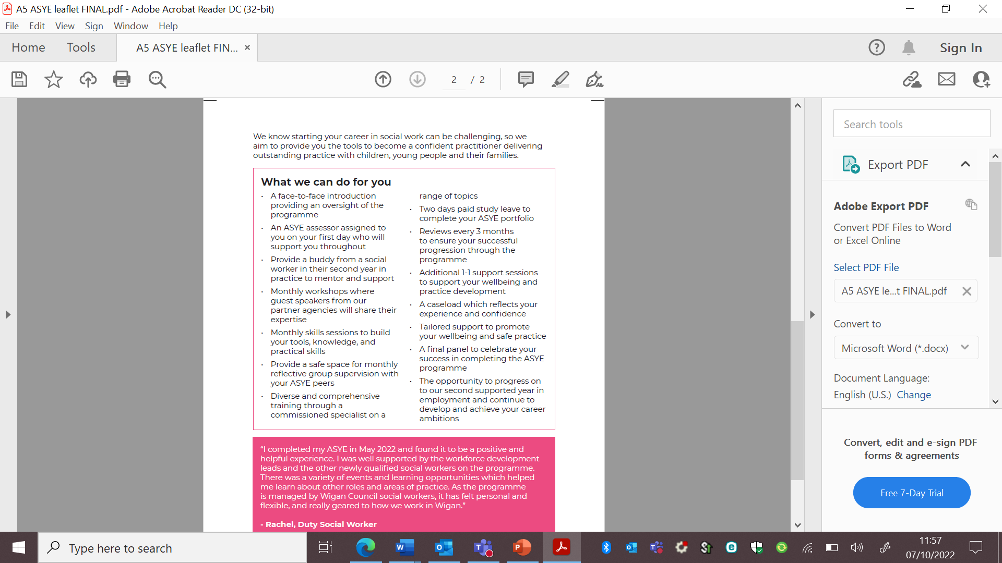
Notes:
LD

Slide 17
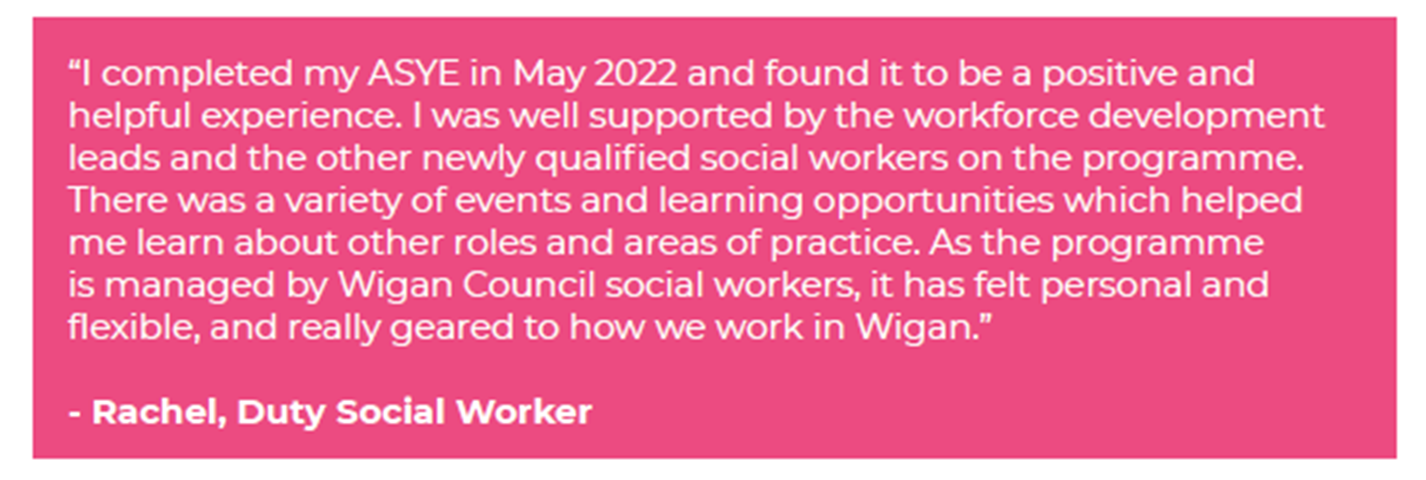
Testimony
Notes:
BH

Slide 18

Testimony
The support from the Workforce Development Leads gave me more confidence in myself and my decision making, I really appreciated opportunities for reflective discussion and learning from other’s experiences, I felt like I always had someone to talk things through with and ask questions or go through processes.
I have recently started my SSYE and have really gained valuable experience of learning from experienced colleagues through the quarterly sessions. They have provided opportunity for thoughtful discussion and I look forward to what the rest of the year has in store!
- Ella, Locality social worker
Notes:
BH

Slide 19
Testimony
The ASYE year was amazing, I had the support of the other ASYE social workers who I could link in with, as and when. I also had great support from the Workforce Development Leads, who where there to offer support/guidance and sometimes just a listening ear.
I am currently coming to the end of my SSYE year and again I have felt fully supported. I have on a number of occasions reached out to the Workforce Development Leads for support, guidance and practical advice. I have found this support invaluable.
- Emma, Children in Care social worker
Notes:
BH

Slide 20
Testimony
I found the ASYE programme to be really supportive, I was never without someone I could go to for help. The Workforce Development Leads are really experienced and have lots of knowledge and practice examples to share. It was also useful to work along other NQSWs from different teams as it gave me insight into services that I otherwise wouldn’t come across.
It’s great to know there is now the offer of an SSYE to support with my continued development and confidence as an autonomous social work practitioner
- Megan, Children in Care social worker
Notes:
BH

