Slide 1
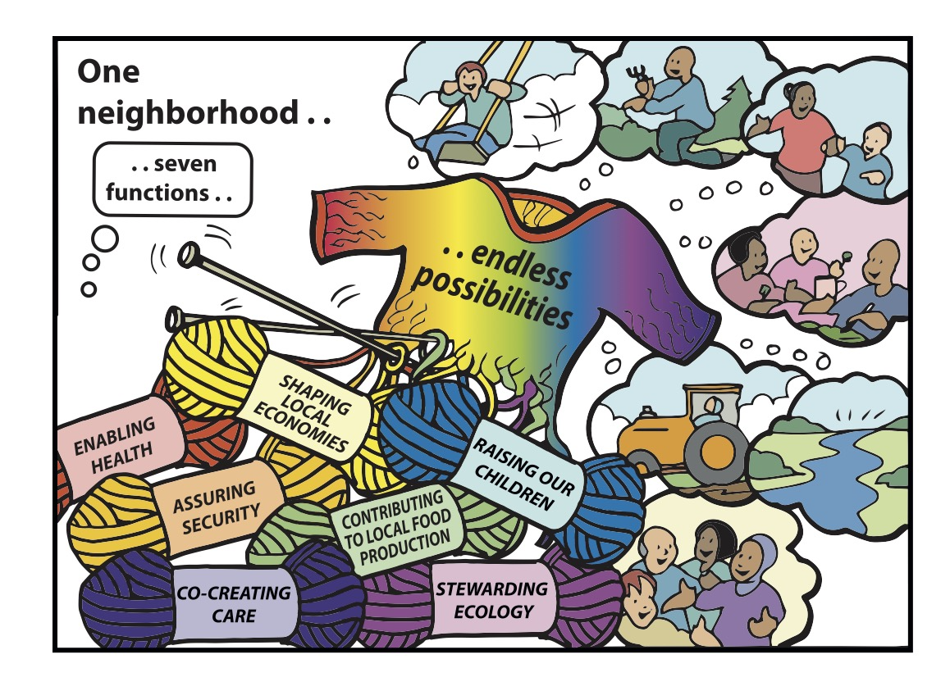
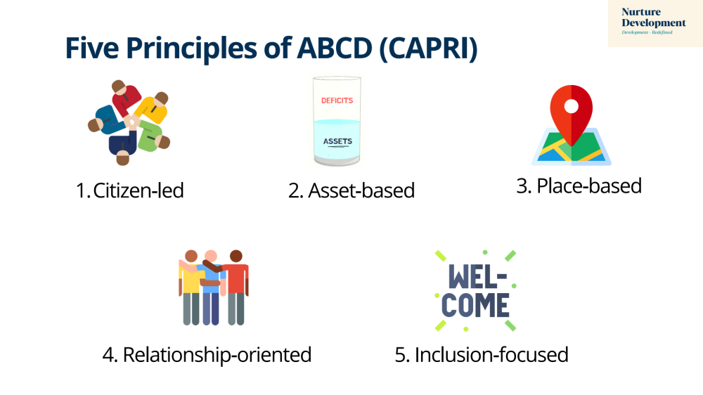
The Neighbourhood
As a Unit of Change

Slide 2
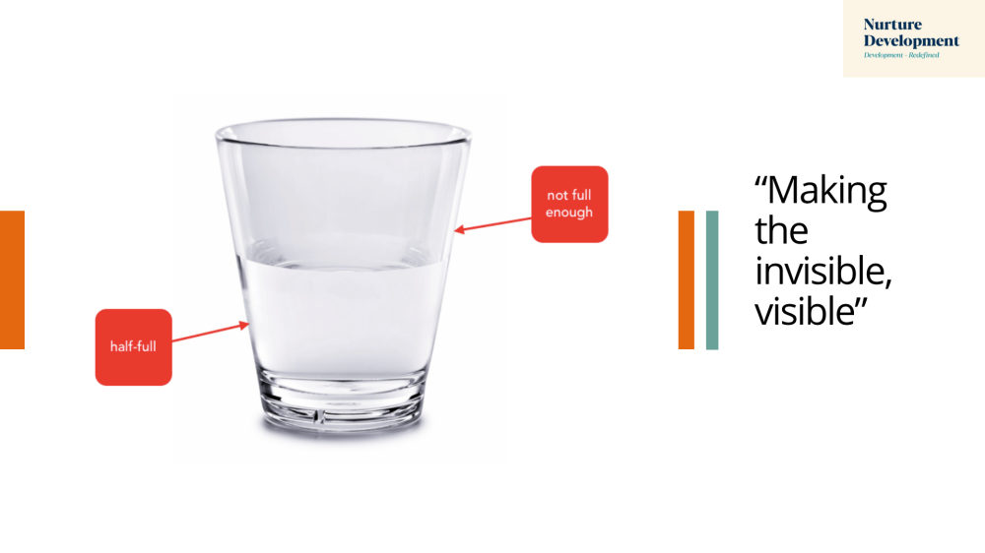

Slide 3

Why ABCD is Crucial
“No society has the money to buy, at market prices, what it takes to raise children, make a neighbourhood safe, care for the elderly, make democracy work or address systemic injustices…..
The only way the world is going to address social problems is by enlisting the very people who are now classified as ‘clients’ and ‘consumers’ and converting them into co-workers, partners and rebuilders of the core economy”
Professor Edgar Cahn, US-based civil rights lawyer and inventor of Timebanks

Slide 4
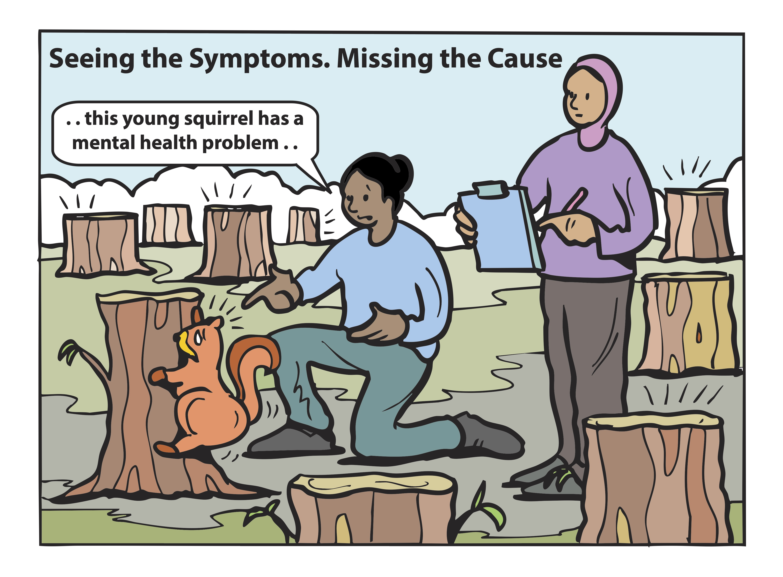
Artwork by Graham Ogilvie. Concept Development by Cormac Russell. Copyright ©Cormac Russell, 2025. Please share with appropriate attribution

Slide 5
Artwork by Graham Ogilvie. Concept Development by Cormac Russell. Copyright ©Cormac Russell, 2025. Please share with appropriate attribution

Slide 6
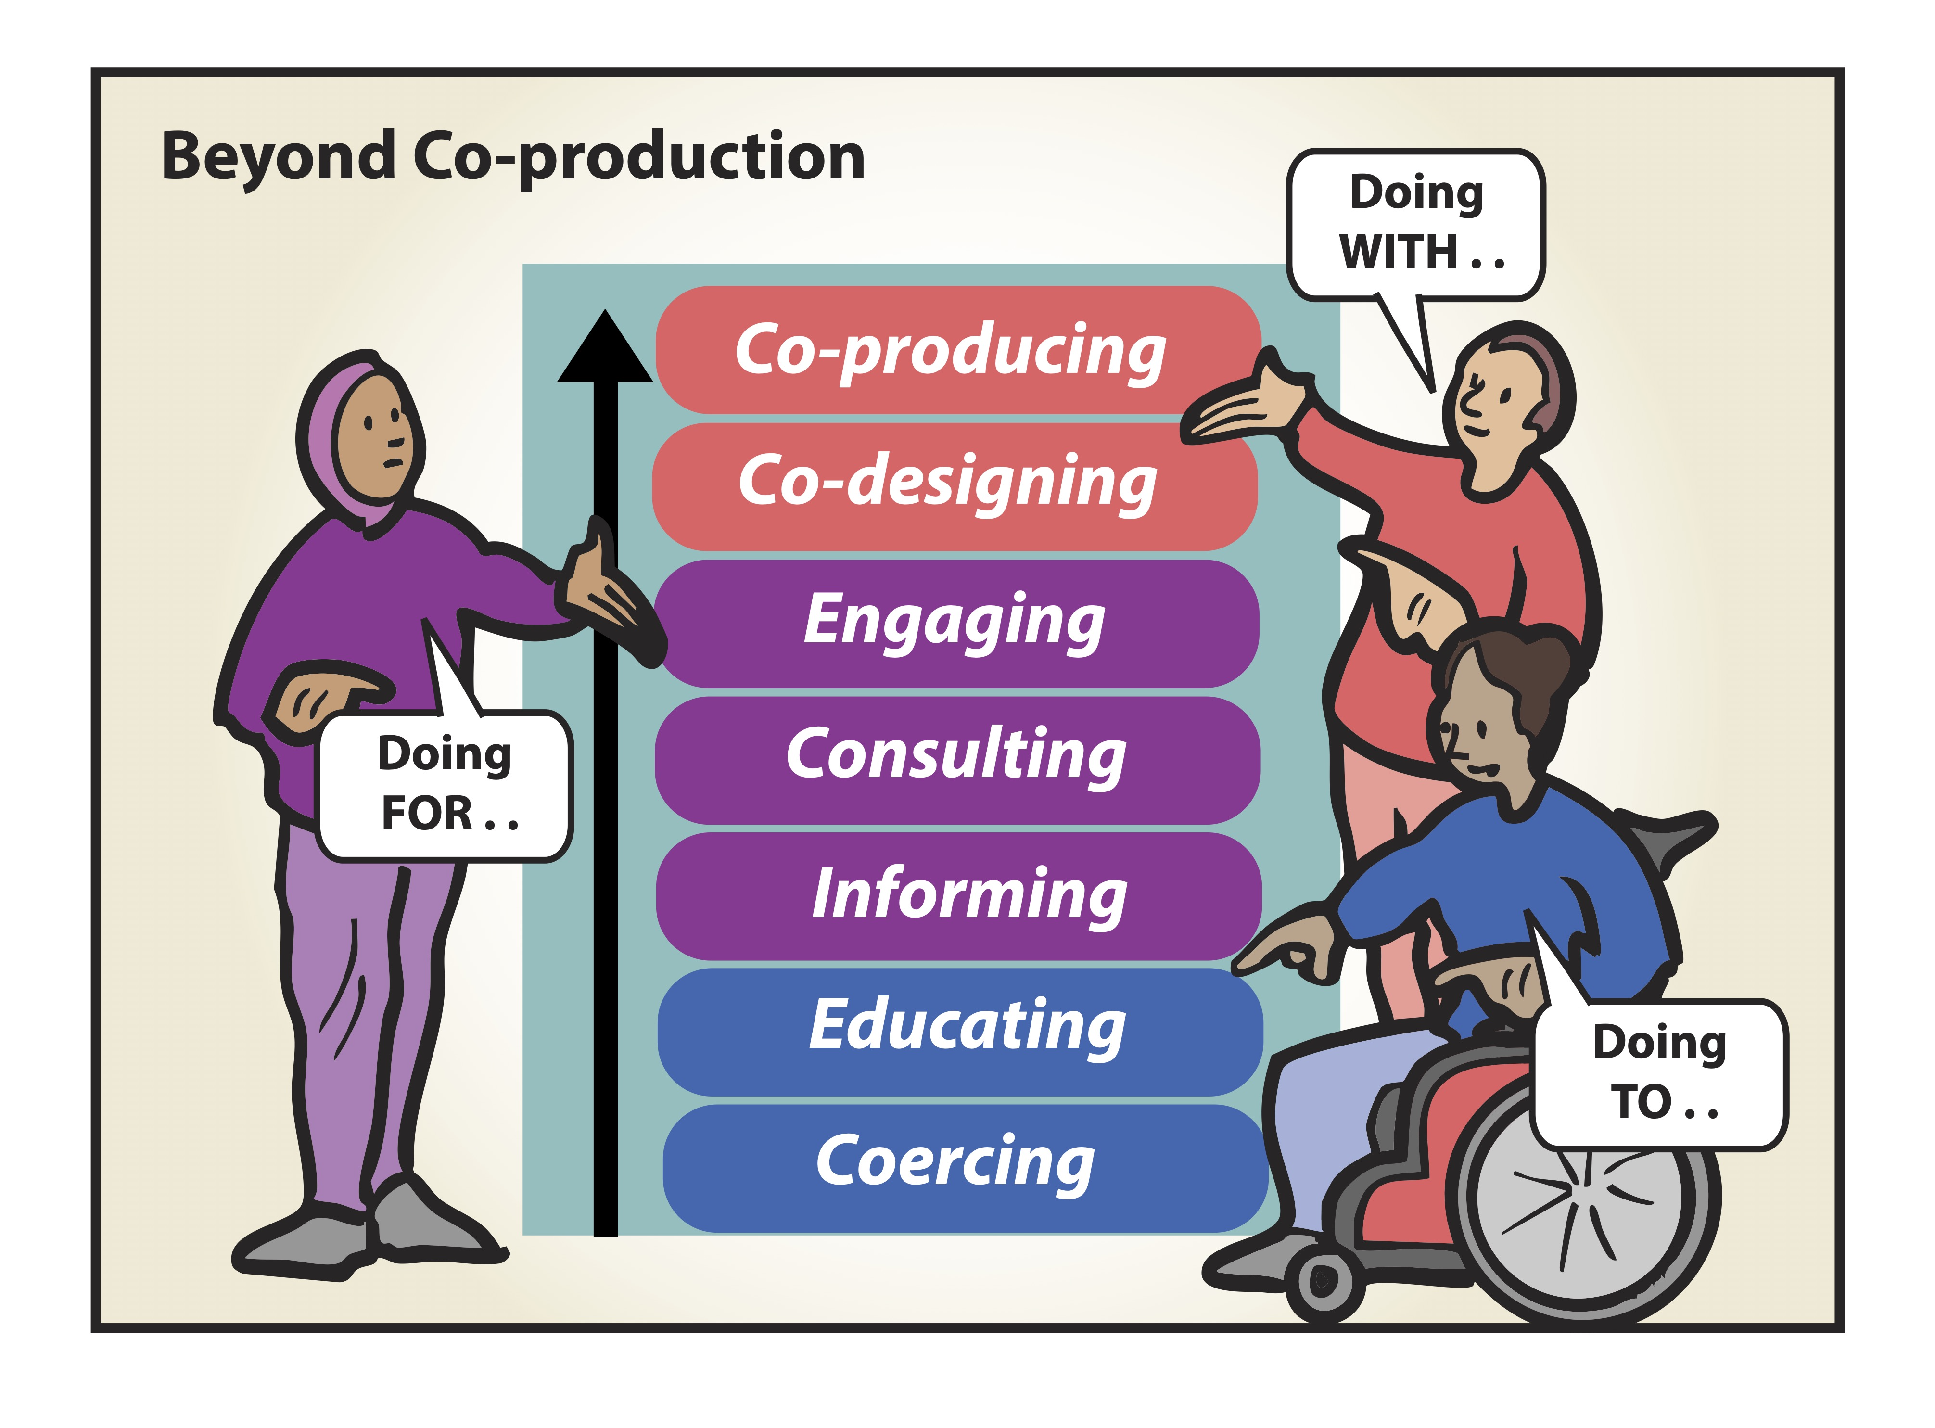
Artwork by Graham Ogilvie. Concept Development by Cormac Russell. Copyright ©Cormac Russell, 2025. Please share with appropriate attribution

Slide 7
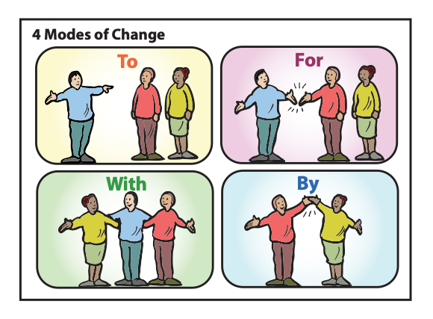
Artwork by Graham Ogilvie. Concept Development by Cormac Russell. Copyright ©Cormac Russell, 2025. Please share with appropriate attribution

Slide 8
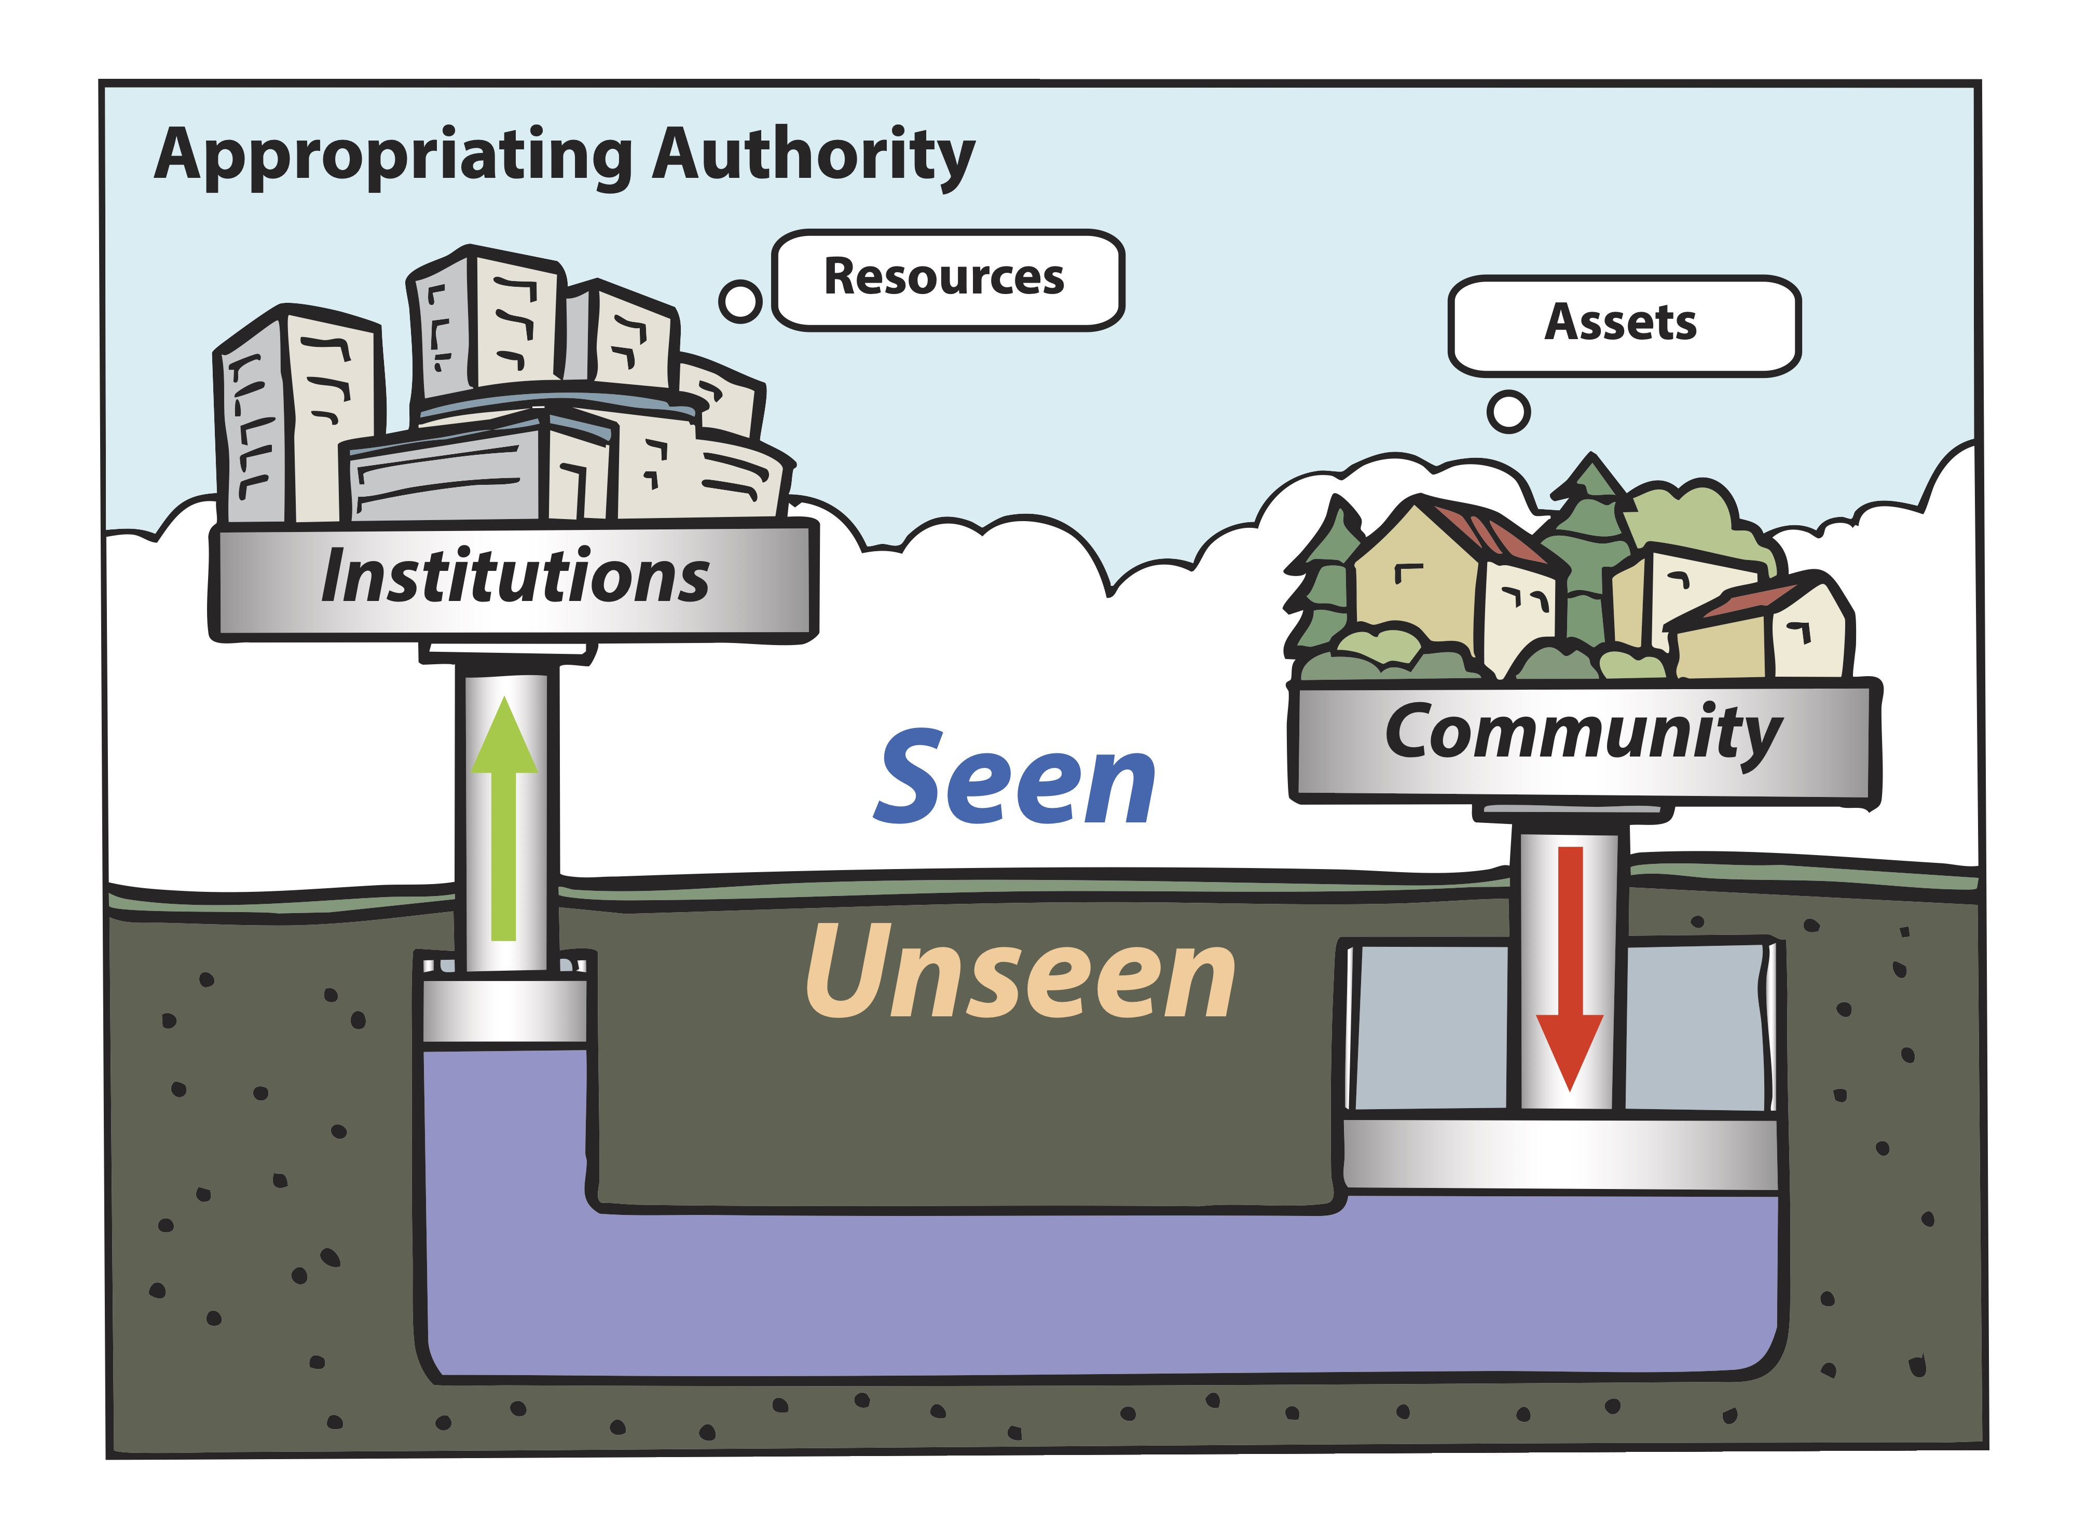
Artwork by Graham Ogilvie. Concept Development by Cormac Russell. Copyright ©Cormac Russell, 2025. Please share with appropriate attribution

Slide 9
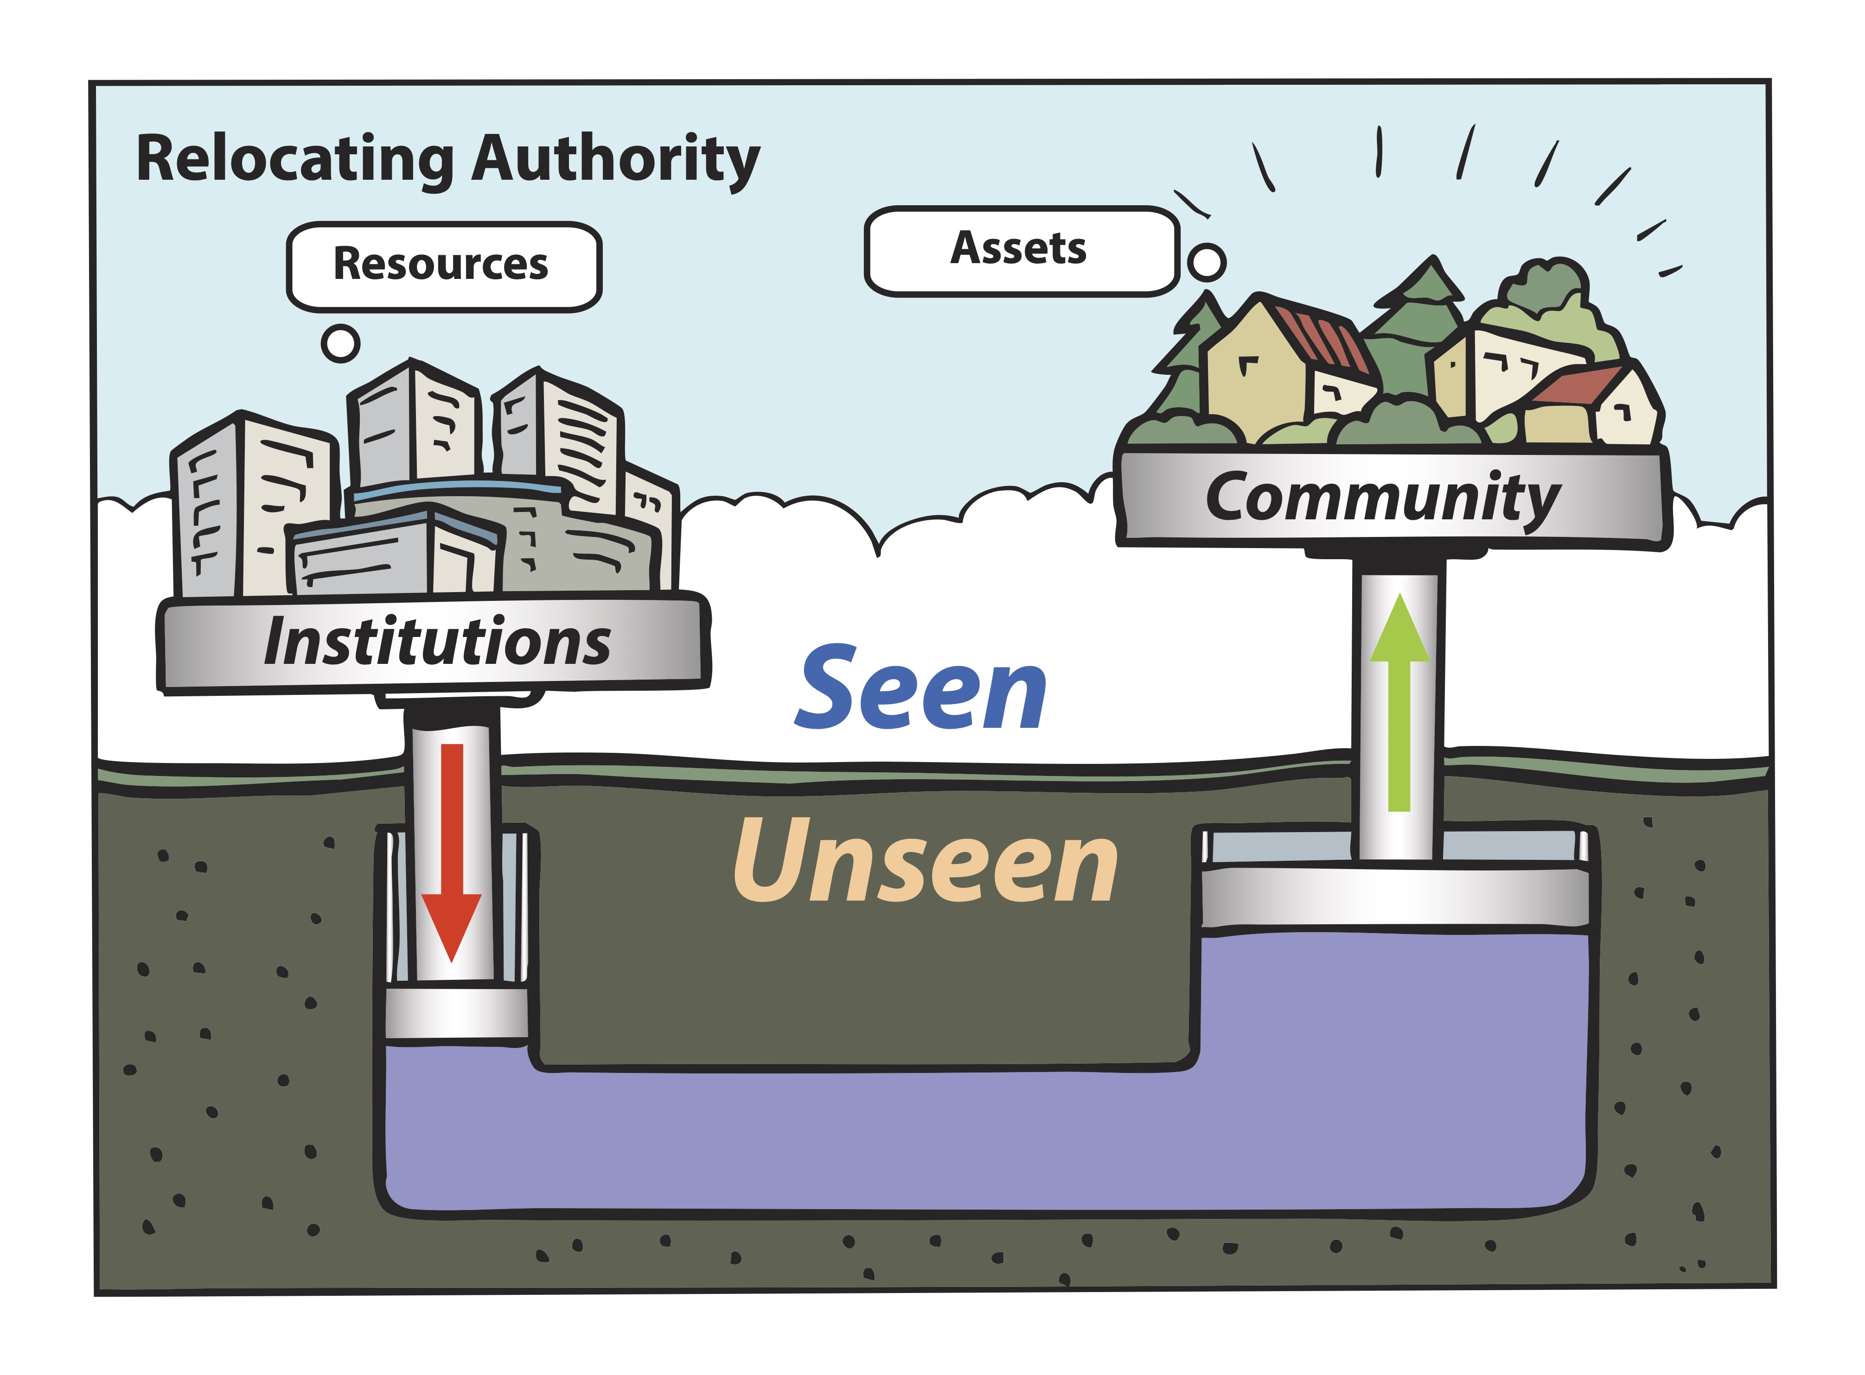
Artwork by Graham Ogilvie. Concept Development by Cormac Russell. Copyright ©Cormac Russell, 2025. Please share with appropriate attribution

Slide 10
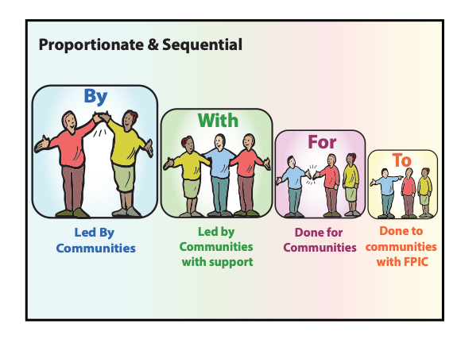
Artwork by Graham Ogilvie. Concept Development by Cormac Russell. Copyright ©Cormac Russell, 2025. Please share with appropriate attribution

Slide 11
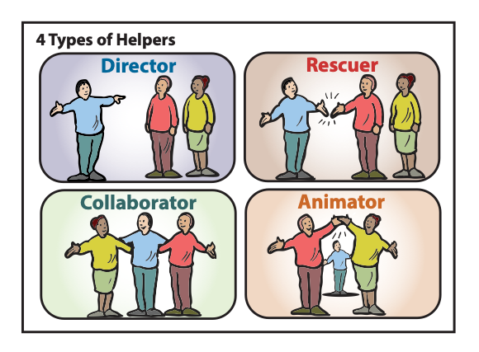
Artwork by Graham Ogilvie. Concept Development by Cormac Russell. Copyright ©Cormac Russell, 2025. Please share with appropriate attribution

Slide 12
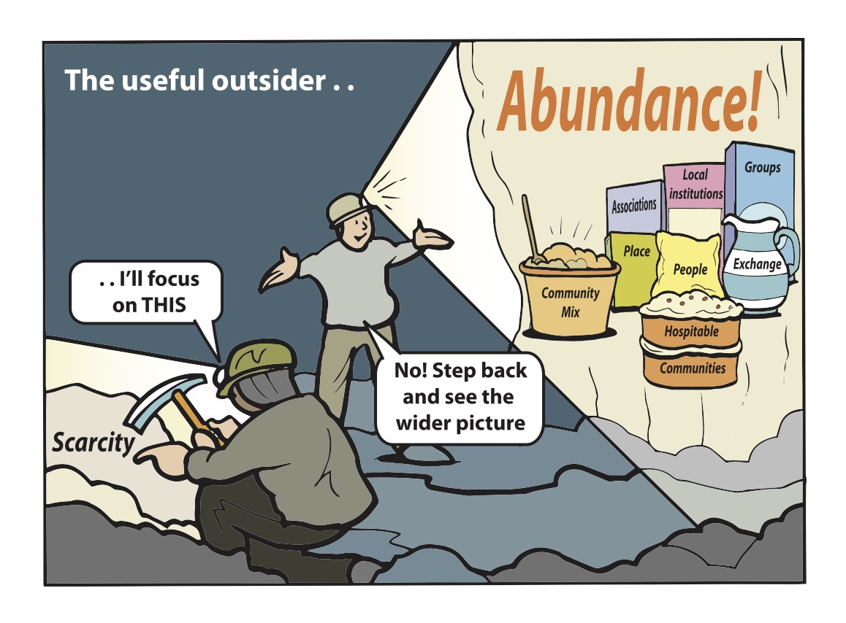
Artwork by Graham Ogilvie. Concept Development by Cormac Russell. Copyright ©Cormac Russell, 2025. Please share with appropriate attribution

Slide 13
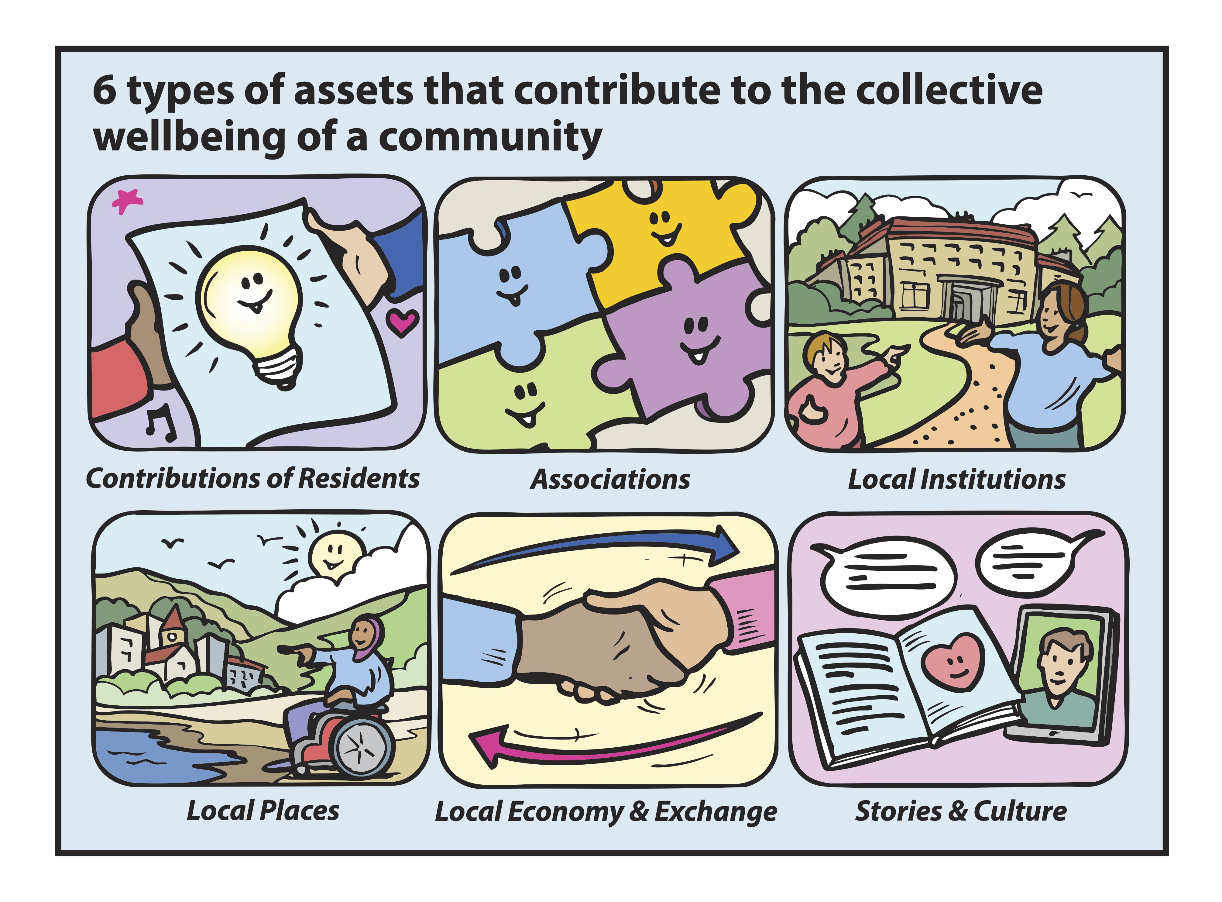
Artwork by Graham Ogilvie. Concept Development by Cormac Russell. Copyright ©Cormac Russell, 2025. Please share with appropriate attribution

Slide 14
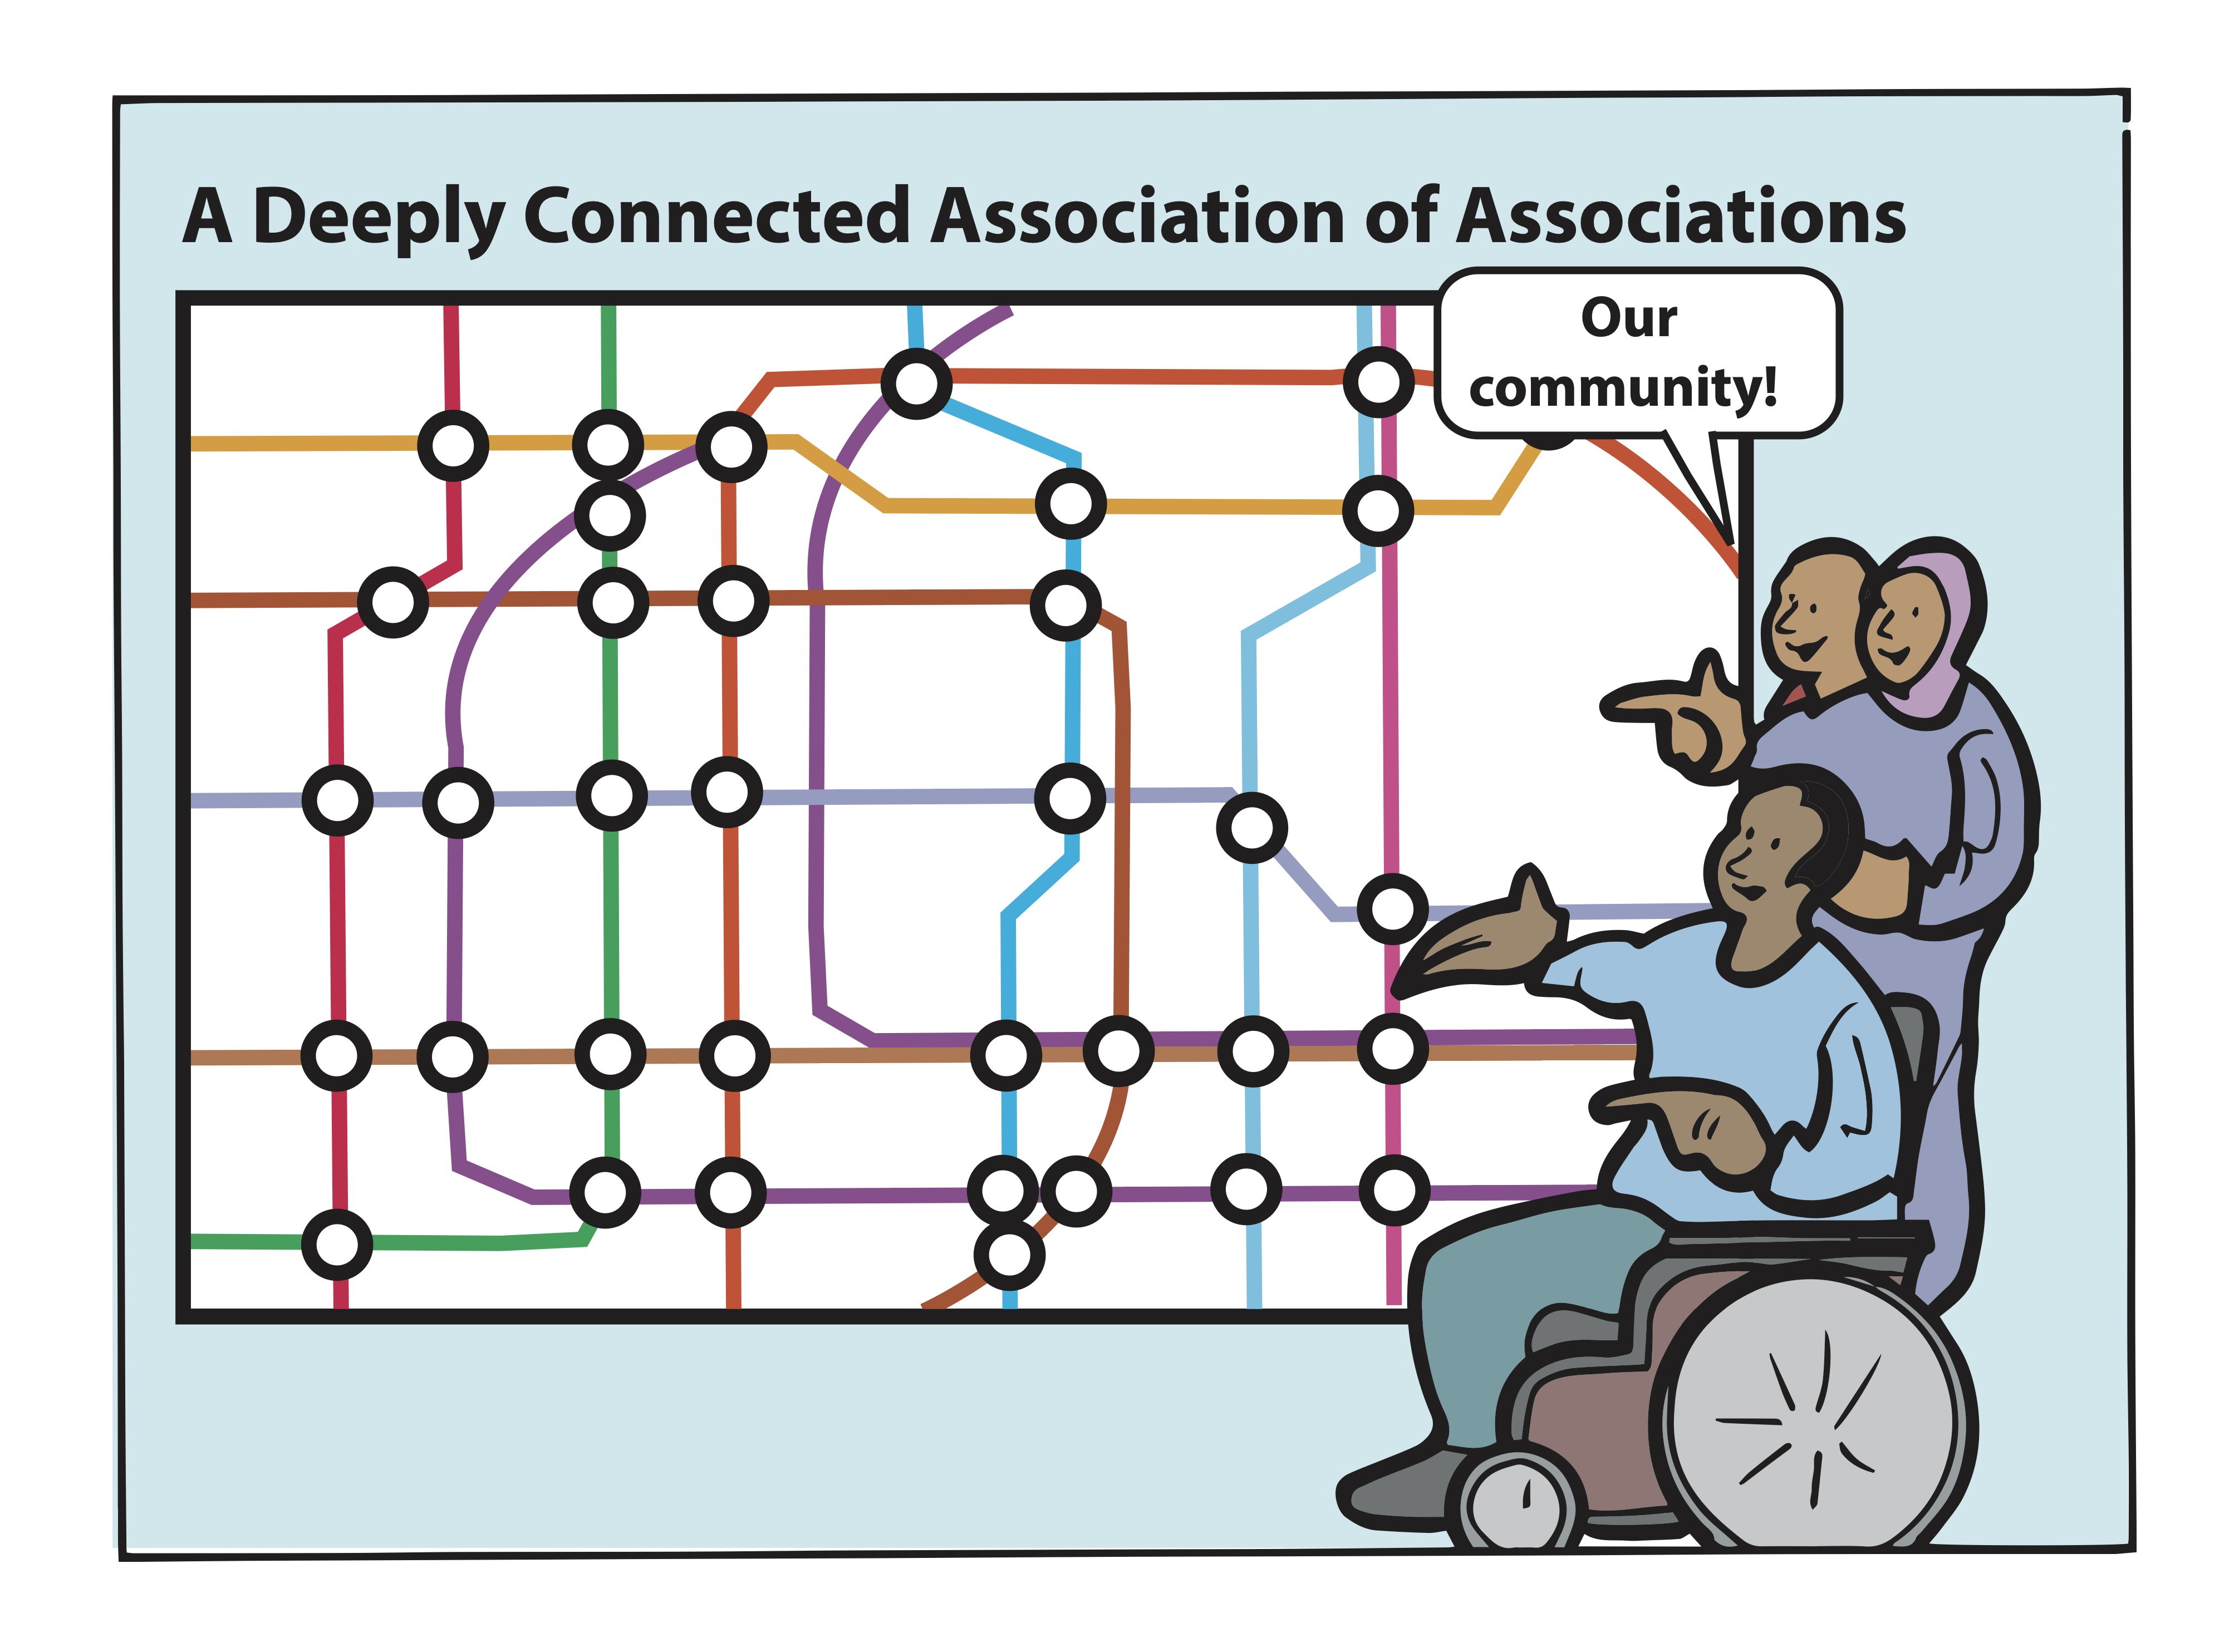
Artwork by Graham Ogilvie. Concept Development by Cormac Russell. Copyright ©Cormac Russell, 2025. Please share with appropriate attribution

Slide 15
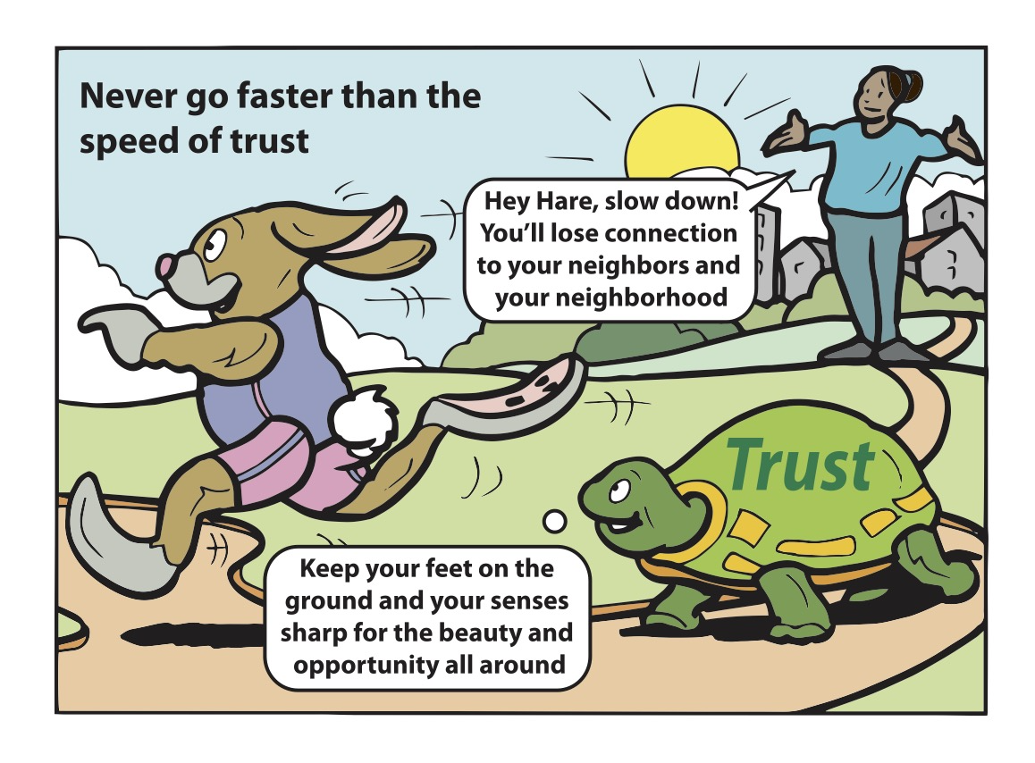
Artwork by Graham Ogilvie. Concept Development by Cormac Russell. Copyright ©Cormac Russell, 2025. Please share with appropriate attribution

Slide 16
Shifting Organisational and staff functions to Support Asset/Strength Based Approaches
Increasing interest in and shift to Asset Based Approaches from range of ‘service areas’
  Arts and Culture (from Community Arts to Art by the community)
  Housing (Tenant Involvement to Tenant led activity)
  Children’s/Education (Nurturing a neighbourhood culture for reading)
  ‘Sports’ Directorate (Active Lifestyles) (From Sports Centres to Photography Group & Pole Dancing!)

Slide 17
Shifting Organisational Functions to Support Asset/Strength Based Approaches
  Community Cohesion (Migrant Access Project)
  Inclusive Growth (Using ABCD to stimulate/nurture local economy)
  Climate Change (Using ABCD to nurture micro initiatives)
  Applying within Population Health Management & Social Prescribing (Informing contracts and ways of working)
  Direct link to Strength Based Social Care (Adults) and Restorative Practice (Children’s)

Slide 18
ABCD in Practice
https://www.youtube.com/watch?app=desktop&v=7ezvHZmkLA4

Slide 19
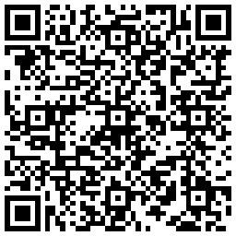
Contact Us
https://communityrenewal.learnworlds.com

